Slide 1
2022-2023 Budget Adoption
June 13, 2022

Slide 2
Wrapping up 2021-2022
Revenue | 2021-22 Revised Budget | 2021-22 Estimated Finish
Local | 58,067,999 | 58,457,119
State | 59,439,498 | 56,992,807
Federal | 1,920,000 | 2,349,190
Total | 119,427,497 | 117,799,116
Expenses | 2021-22 Revised Budget | 2020-21 Estimated Finish
Payroll | 91,415,803 | 92,212,534
Contracted Services | 13,821,781 | 11,940,114
Supplies | 3,877,771 | 3,581,627
Misc. Operating | 2,934,947 | 2,802,439
Debt Service | 112,408 | 1,901,954
Capital Outlay | 204,739 | 203,781
Total | 112,367,449 | 112,642,449
Excess/Deficit | 7,060,048 | 5,156,667
Notes:
Add note about amount collected for PVS

Slide 3
Fund Balance Summary – General Fund
 | General Fund
Beginning Fund Balance | 36,222,707
2021-22 Total Excess | 5,156,667
Resolution to Transfer to Capital Projects/GASB 87 | (11,696,305)
Estimated Fund Balance as of June 30, 2022 | 29,683,069
Net Change | (6,539,638)

Slide 4
Tax Rate Trend

Slide 5
Property Value Trend

Slide 6
Local Revenue
April 2021 Preliminary Taxable Value
Johnson County - $3,771,725,925
Tarrant County - $2,009,601,692
July 2021 Certified Taxable Value
Johnson County - $3,814,810,686
Tarrant County - $1,981,445,606
April 2022 Preliminary Taxable Value
Johnson County - $4,111,261,316
8% growth
Tarrant County – $2,237,317,242
13% growth

Slide 7
Enrollment/ADA Trend

Slide 8
Budget Considerations
Payroll
New Teacher/Nurse Matrix
Beginning Pay $58,000
4%+ increase
Non-Teacher
3% of midpoint
Adjustments as needed
Notes:
2.5% midpoint last year was $617,876, 3% was $734,521

Slide 9
Teacher/Nurse Matrix
Year | 0-Year Salary | 5-Year Salary | 10-Year Salary | 15-Year Salary | 20-Year Salary | 25-Year Salary
2022-2023 | 58,000 | 60,052 | 62,039 | 64,113 | 66,057 | 68,298
2021-2022 | 56,800 | 57,298 | 59,540 | 61,214 | 63,752 | 66,128
Notes:
2.5% midpoint last year was $617,876, 3% was $734,521

Slide 10
Accelerated Education
The Texas Education Code requires a school district to provide each student who fails to perform satisfactorily on an End of Course assessment with accelerated instruction in the applicable subject area. HB 5, 83rd Texas Legislature in 2013 has emphasized this amount be included separately in the adopted budget.
Amount to Approve $296,350
Notes:
2.5% midpoint last year was $617,876, 3% was $734,521

Slide 11
General Fund
Revenue | 2022-23 Proposed
Local | 60,491,136
State | 57,512,164
Federal | 2,440,000
Total | 120,443,300
Expenses | 2022-23 Proposed
Payroll | 96,568,939
Cont. Services | 13,819,029
Supplies | 4,603,695
Misc. Operating | 3,305,620
Debt Service | 112,408
Capital Outlay | 108,146
Total | 118,517,837
Excess/Deficit | 1,925,463

Slide 12
Food Service
Revenue | 2021-22 Revised Budget | 2021-22 Estimated Finish | 2022-23 Proposed
Local | 650,000 | 592,541 | 3,025,000
State | 135,000 | 74,485 | 125,000
Federal | 7,826,240 | 8,925,797 | 3,500,000
Total | 8,611,240 | 9,592,823 | 6,650,000
Expenses | 2021-22 Revised Budget | 2021-22 Estimated Finish | 2022-23 Proposed
Food Service (35) | 7,046,085 | 7,505,738 | 8,234,232
Operations (51) | 35,000 | 35,000 | 35,000
Total | 7,081,085 | 7,540,738 | 8,269,232
Excess/Deficit | 1,530,155 | 2,052,085 | (1,619,232)
Fund Balance may not exceed three months operational expenses.
Fund balance will be used on new equipment and upgrades software.

Slide 13
Debt Service
Revenue | 2021-22 Original Budget | 2021-22 Estimated Finish | 2022-23 Proposed
Local | 28,506,638 | 28,924,322 | 30,885,154
State | 431,809 | 455,571 | 493,759
Total | 28,938,447 | 29,379,893 | 31,378,913
Expenses | 2021-22 Original Budget | 2021-22 Estimated Finish | 2022-23 Proposed
Debt Service | 22,887,204 | 22,634,153 | 23,012,516
Total | 22,887,204 | 22,634,153 | 23,012,516
Excess/Deficit | 6,051,243 | 6,745,740 | 8,366,397

Slide 14
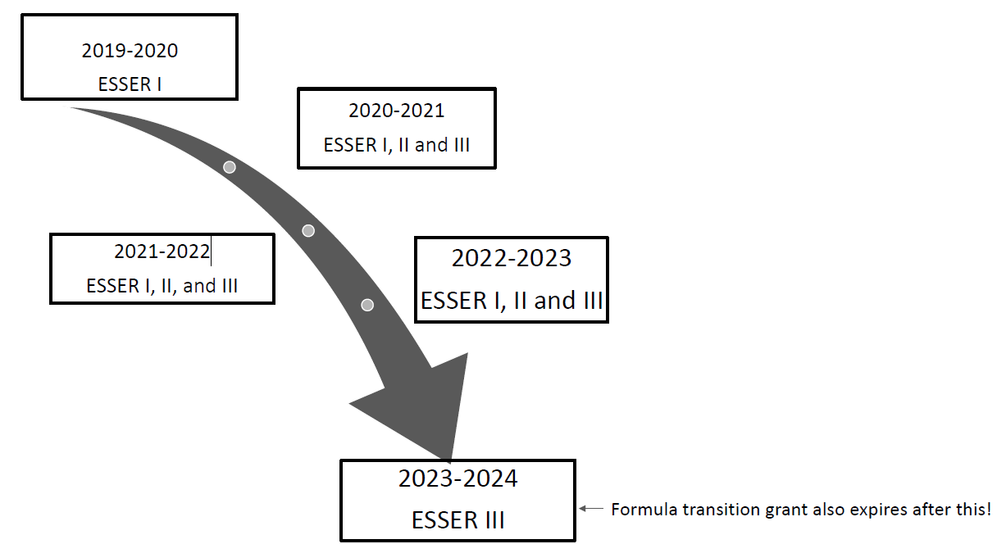
Notes:
2.5% midpoint last year was $617,876, 3% was $734,521

Slide 15
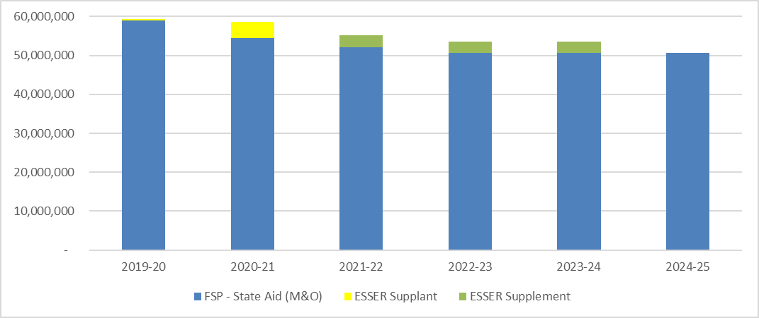
Fiscal Cliff
Notes:
2.5% midpoint last year was $617,876, 3% was $734,521

Slide 16
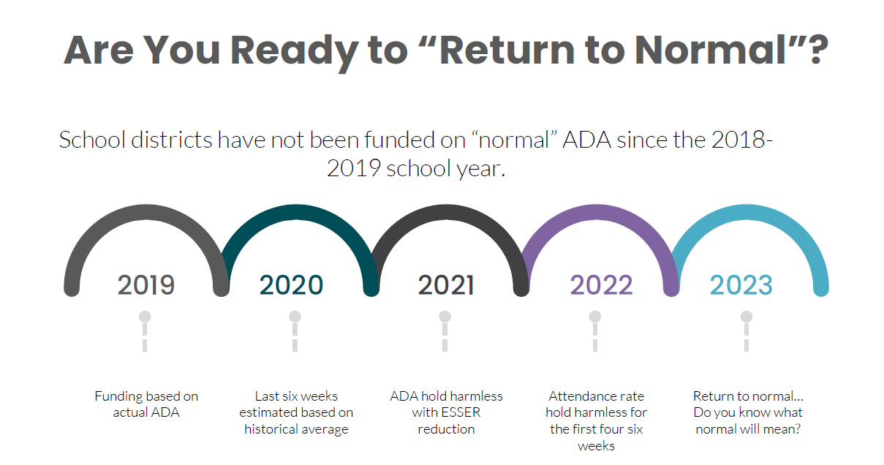
Notes:
2.5% midpoint last year was $617,876, 3% was $734,521

Slide 17
Questions?
Notes:
2.5% midpoint last year was $617,876, 3% was $734,521

Slide 18
General Fund
Notes:
2.5% midpoint last year was $617,876, 3% was $734,521

Slide 19
Food Service
Notes:
2.5% midpoint last year was $617,876, 3% was $734,521

Slide 20
Debt Service
Notes:
2.5% midpoint last year was $617,876, 3% was $734,521

Slide 21
Requisitions Over $25,000
Notes:
2.5% midpoint last year was $617,876, 3% was $734,521

Slide 22
General Fund Amendment
Notes:
2.5% midpoint last year was $617,876, 3% was $734,521

Slide 23
Food Service Amendment
Notes:
2.5% midpoint last year was $617,876, 3% was $734,521

Slide 24
Debt Service Amendment
Notes:
2.5% midpoint last year was $617,876, 3% was $734,521

